Slide 1
Web Service Development Within Different Study Years
Maja Pušnik, Boštjan Šumak
Institute of Informatics, FERI Maribor

Slide 2
Renewed study programs
Electrical Engineering
Computer Science and Information Technologies
Informatics and Technologies of Communication
Media Communications
Telecommunications
Industrial Engineering – option Electrical Engineering
Mechatronics

Slide 3
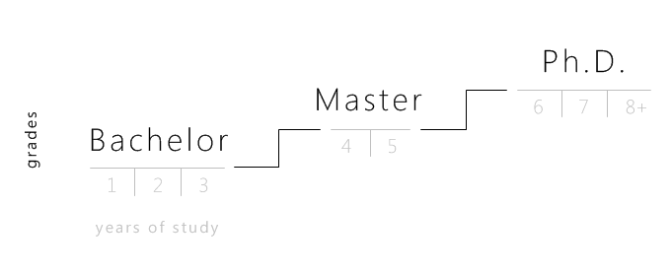
Organisation
Pre-Bologna system
Professional study program (6 semesters)
Academic study program (9 semesters)
Bologna system
First Cycle Bologna Study Programs
Professional study program (6 semesters)
Academic study program (6 semesters)
Second Cycle Bologna Study Programs
4 semesters
Third Cycle Bologna Study Programs – study to receive a PhD

Slide 4
Year 1 | 1. sem | Informatics and technologies of communication Communication and teamwork Mathematics I ICT basics From the problem to the code
 | 2. sem | Advanced Software Programming Data Structures The use of multimedia systems Web technologies and annotation languages SQL programming
Year 2 | 3. sem | Databases I Discrete Mathematics Information System Architectures IS Design and Development Project Management and Communication Optional Subject 1*
 | 4. sem | Dynamic Web Solutions Decision Support Systems Introduction to Computer Security Application Development Tools Information processes
Year 3 | 5. sem | Study option System support to informatics and technologies of communication Optional Subject 2 ICT Management ICT System Support Information Management Data Warehousing and reporting Information Networks And Equipment | Study option Information System Development Optional Subject 2 Data Organizing and Processing Requirements Engineering and Management Development of Information Services Design Patterns Databases II | Study option Technologies of Multimedia Communication Optional Subject 2 The use of multimedia communications and services Computer Graphics and Animation Communication and content management Portals And Knowledge Systems Visual communications
 | 6. sem | Information Systems Development Environments Internship
 |  | Diploma work
ICT - Bologna level I courses (professional study program)
* Student can choose any optional subject from high professional study programmes at the University of Maribor (free
elective subject).

Slide 5
ICT - Bologna level I courses (professional study program)
SUBJECT | Semester | ECT | V3.1 | V3.2 | V3.3
ICT SYSTEM SUPPORT | Winter | 5 | 1* | 1 | 1
INFORMATION MANAGEMENT | Winter | 5 |  | 1
DATA WAREHOUSING AND REPORTING | Winter | 5 |  | 1
ICT MANAGEMENT | Winter | 5 |  | 1
INFORMATION NETWORKS AND EQUIPMENT | Winter | 5 |  | 1
DATA ORGANIZING AND PROCESSING | Winter | 5 | 1 |  | 1*
REQUIREMENTS ENGINEERING AND MANAGEMENT | Winter | 5 | 1
DEVELOPMENT OF INFORMATION SERVICES | Winter | 5 | 1 | 1* | 1*
DESIGN PATTERNS | Winter | 5 | 1
DATABASES II | Winter | 5 | 1
THE USE OF MULTIMEDIA COMMUNICATIONS AND SERVICES | Winter | 5 | 1* | 1* | 1
COMPUTER GRAPHICS AND ANIMATION | Winter | 0 |  |  | 1
PORTALS AND KNOWLEDGE SYSTEMS | Winter | 5 | 1* |  | 1
VISUAL COMMUNICATIONS | Winter | 5 |  |  | 1
INFORMATION SYSTEMS DEVELOPMENT ENVIRONMENTS | Summer | 5 | 1 | 1 | 1
COMMUNICATION AND CONTENT MANAGEMENT | Winter | 5 | 1* | 1* | 1
ANY SUBJECT VS PROFESSIONAL PROGRAM OF UM |  | 5 | 1* | 1* | 1*
FREE SELECTION SUBJECT II |  | 5 | 1 | 1 | 1
INTERNSHIP | Summer | 15 | 1 | 1 | 1
BACHELOR THESIS | Summer | 10 | 1 | 1 | 1
Notes:
INFORMATICS AND TECHNOLOGIES OF COMMUNICATION
1. INFORMATION SYSTEM DEVELOPMENT
2. SYSTEM SUPPORT TO INFORMATICS AND TECHNOLOGIES OF COMMUNICATION
3. TECHNOLOGIES OF MULTIMEDIA COMMUNICATION

Slide 6
Year 1 | 1. sem | Introduction to information systems Problem solving with programming Computer Systems Basics Methodologies and Technologies of Communication Mathematics I
 | 2. sem | Object-Oriented Programming in Java Databases I Basics of Web Technologies Optional subjects 1*
 |  | Practical Course I
Year 2 | 3. sem | Development of Information Systems Mathematics II Decision Making Models and Systems Integrated development environments and group communications Optional subjects 2*
 | 4. sem | Discrete structures Business process modeling IS Architectures and Patterns Portal Technologies and Knowledge Management
 |  | Practical Course II
Year 3 | 5. sem | Study option Information Systems Security and protection System Convergence and Integration Auditing Information Systems Portal Technologies and Knowledge Management Optional subjects 4* | Study option Technologies of Communications Security and protection System Convergence and Integration Normative Aspect of Information Society and Electronic Communication Development of ubiquitous information solutions Optional subjects 4*
 | 6. sem | Project Management Statistics Optional subjects 5*
 |  | Practical Course III
 |  | Diploma work
ICT - Bologna level I courses (academic study program)
* Student can choose any subject from the university programmes at the Faculty of Electrical Engineering and Computer
Science

Slide 7
Academic study program 3rd year
SUBJECTz | Semester | ECT | U3.1 | U3.2
WEB PROGRAMMING | Summer | 6 | 1* | 1*
SYSTEM ADMINISTRATION | Summer | 6 | 1* | 1*
EMBEDDED SYSTEMS | Winter | 6 | 1* | 1*
COMPUTER EQUIPMENT TESTING | Winter | 6 | 1* | 1*
SECURITY AND PROTECTION | Winter | 6 | 1 | 1
SYSTEM CONVERGENCE AND INTEGRATION | Winter | 6 | 1 | 1
AUDITING INFORMATION SYSTEMS | Winter | 6 | 1 | 1*
PORTAL TECHNOLOGIES AND KNOWLEDGE MANAGEMENT | Winter | 6 | 1 | 1*
NORMATIVE ASPECT OF INFORMATION SOCIETY AND ELECTRONIC COMMUNICATION | Winter | 6 | 1* | 1
DEVELOPMENT OF UBIQUITOUS INFORMATION SOLUTIONS | Winter | 6 | 1* | 1
PROJECT MANAGEMENT | Summer | 6 | 1 | 1
STATISTICS | Summer | 6 | 1 | 1
PRACTICAL COURSE III | Summer | 6 | 1 | 1
BACHELOR THESIS | Summer | 6 | 1 | 1
PRACTICAL COURSE: WEB SYSTEMS | Summer | 6 | 1* | 1*
OPTIONAL SUBJECT IV |  | 6 | 1 | 1
OPTIONAL SUBJECT V |  | 6 | 1 | 1
DYNAMIC WEB SOLUTIONS | Winter | 6 | 1* | 1*
Notes:
BU31 INFORMATION SYSTEMS
BU32 TECHNOLOGIES OF COMMUNICATION

Slide 8
Practical courses
First Year
basic concepts
basic technological skills
Practical Course 1:
A feedback how well students adopted the given knowledge and know how to use it
basic implementation, individual work
Second Year
advanced technological skills
basic organizational and business skills
Practical Course 2:
design and implementation,
team work
Third Year
top technological skills
organizational and business skills
specialization
Practical Course 3:
project planning and management, team work

Slide 9
Work plan
From 2009/2010 – 2011/2012
Project oriented work
From 2012/2013 - 2013/2014
Week to week work

Slide 10
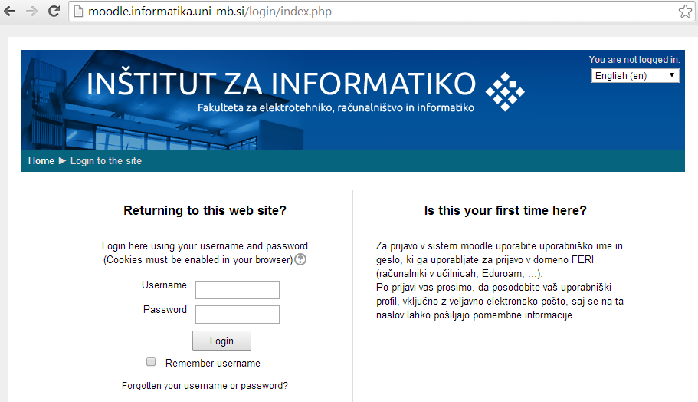
Using Moodle since 2008

Slide 11
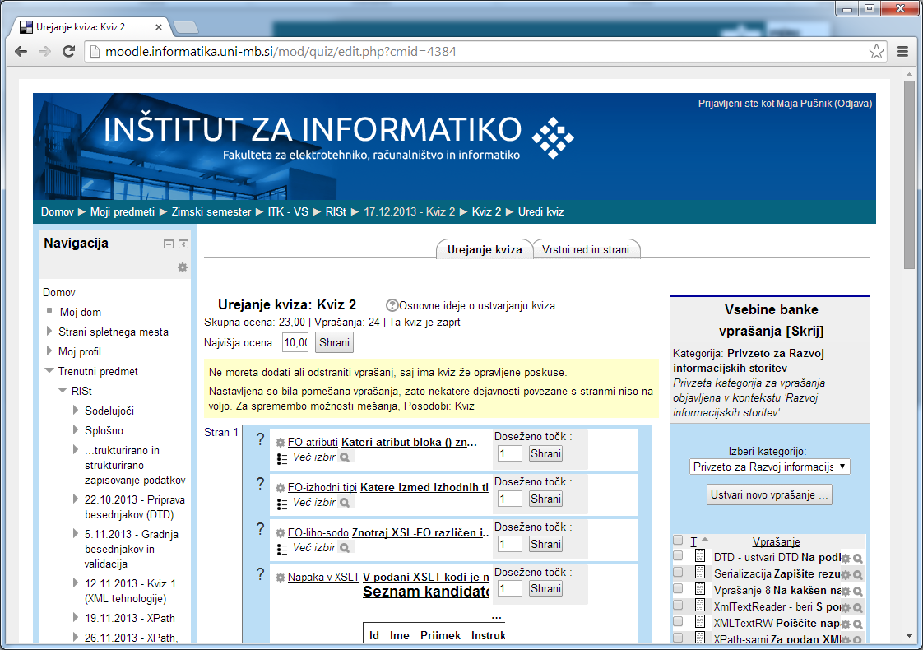
Using Quizzes

Slide 12
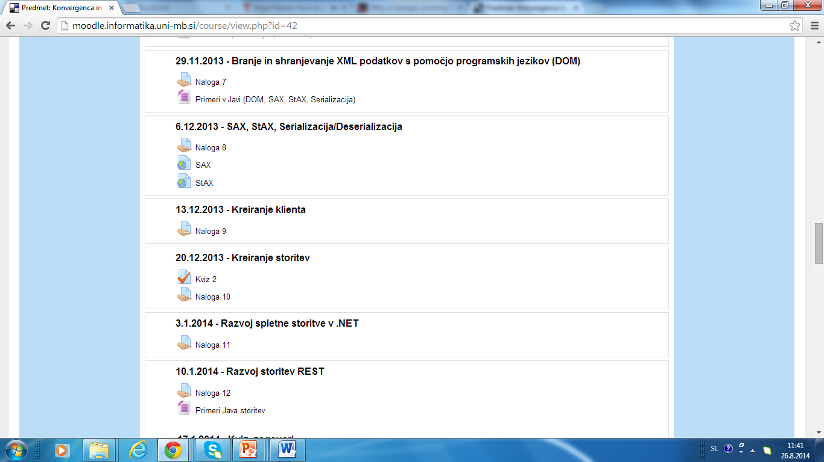
Weekly assignments

Slide 13
The learning process in WS development oriented subjects
HTML and related
XML and related technologies
XML manipulation in Java/C#
WS and integration (SOAP, REST)

Slide 14
Web Service Development in 1st year academic study program (Basics of Web Technologies)
HTML and related
XML and related technologies
XML manipulation in Java/C#
WS and integration (SOAP, REST)

Slide 15
Web Service Development in 3d year academic study program (System Convergence and Integration)
HTML and related
XML and related technologies
XML manipulation in Java/C#
WS and integration (SOAP, REST)

Slide 16
Results (Basics of Web Technologies)
Year | N of students | % 10 | % 9 | % 8 | % 7 | % 6 | % fail | Average grade | Average passed grade
2009 | 79 | 14% | 9% | 10% | 11% | 9% | 47% | 6,67 | 8,14
2010 | 80 | 5% | 10% | 24% | 21% | 8% | 33% | 6,86 | 7,76
2011 | 75 | 4% | 3% | 16% | 19% | 7% | 52% | 6,23 | 7,56
2012 | 72 | 0% | 4% | 14% | 19% | 18% | 44% | 6,15 | 7,07
2013 | 62 | 0% | 2% | 6% | 16% | 23% | 53% | 5,81 | 6,72

Slide 17
Results (Basics of Web Technologies)

Slide 18
Results (Basics of Web Technologies)

Slide 19
Results (System Convergence and Integration)
Year | N of students | % 10 | % 9 | % 8 | % 7 | % 6 | % fail | Average grade | Average passed grade
2009 | 53 | 4% | 30% | 9% | 13% | 4% | 40% | 6,98 | 8,28
2010 | 66 | 3% | 14% | 14% | 17% | 5% | 48% | 6,48 | 7,88
2011 | 66 | 6% | 11% | 8% | 12% | 11% | 53% | 6,30 | 7,77
2012 | 54 | 2% | 9% | 22% | 19% | 17% | 31% | 6,67 | 7,43
2013 | 29 | 7% | 10% | 17% | 7% | 17% | 41% | 6,59 | 7,71

Slide 20
Results (System Convergence and Integration)

Slide 21
Results (System Convergence and Integration)

Slide 22
Results (Development of Information Services)
Year | N of students | % 10 | % 9 | % 8 | % 7 | % 6 | % fail | Average grade | Average passed grade
2009 | 10 | 10% | 30% | 30% | 10% | 10% | 10% | 7,9 | 8,22
2010 | 19 | 0% | 16% | 37% | 11% | 0% | 37% | 6,94 | 8,08
2011 | 15 | 13% | 13% | 7% | 7% | 7% | 53% | 6,6 | 8,43
2012 | 26 | 4% | 19% | 15% | 35% | 8% | 19% | 7,19 | 7,71
2013 | 19 | 3% | 8% | 5% | 16% | 11% | 8% | 7,05 | 7,44

Slide 23
Results (Development of Information Services)

Slide 24
Results (Development of Information Services)

Slide 25
Results (Practical Course 1)
Year | % 10 | % 9 | % 8 | % 7 | % 6 | % fail | Average grade | Average passed grade
2010 | 83% | 0% | 4% | 7% | 0% | 7% | 9,39 | 9,76
2011 | 33% | 37% | 17% | 4% | 4% | 4% | 8,76 | 8,93

Slide 26
Results (Practical Course 3)
Year | % 10 | % 9 | % 8 | % 7 | % 6 | % fail | Average grade | Average passed grade
2010 | 21% | 18% | 18% | 0% | 0% | 42% | 7,33 | 9,05
2011 | 20% | 8% | 12% | 10% | 16% | 33% | 7,08 | 8,09
2012 | 19% | 36% | 17% | 4% | 9% | 15% | 8,08 | 8,62

Slide 27
ICT - Bologna level II courses
Development of Information Systems and Services
Service Oriented Architectures
Data Modeling and Databases
Optimization of Business Processes
Information Technologies and Services Management
Mandatory
Subjects
1.sem
M1: Business Process Management
M2: Intelligent Information Solutions
M3: Modern IT Platforms and Architectures
Business Process Management
Electronic Commerce
ERP Systems
Intelligent Systems
Development Technologies for Intelligent Solutions
Business Intelligence and Data Quality
IT Architectures
Ubiquitous Applications Technologies
Web Technologies
MODULES
+ 2 Optional Subjects
2.sem
2.sem
2.sem
MODULES
M4: IT Security and Security Management
M5: Service Science
M6: Communicating and Collaboration
Advanced Information Security
Data protection
Dependability and testing of IS
Service Science and Innovations
Services Management and Marketing
Operations Research
Technical Communication in Informatics
Strategic Planning
Communicating with customers and users
+ 2 Optional Subjects
3.sem
3.sem
3.sem
4.sem
Empirical Research Methods +
Master's Thesis

Slide 28
Service Oriented Architecture
Students from different study programs with different backgrounds
Difficulties with basic concepts
The motivation level only slightly higher

Slide 29
Conclusion
Week to week work
Harder work through the year, less stress in the end
Working on simpler tasks
Failing to build more complex projects
Lower grades, more fair grades?
Project oriented work
Work depends on individual effort/interest
More complex project implemented
Mostly better grades
In group work one does most of the work

Slide 30
Thank you!
Questions?

